Slide 1


Airbnb NYC
Price Analysis
$
44.2%
From Raw Listings to Pricing Insight - A Full EDA Journey
of listings in Manhattan
Presented by:
SHAILESH PAWAR
%
Start Presentation →
LinkedIn
GitHub
!
48,895
16
264
$105
Raw Listings
Columns
Rows Removed
Median Price

Slide 2
PROJECT BRIEF
Problem Statement & Objective
!
Problem Statement
>
Objective
• Airbnb hosts often struggle to price listings correctly
• Underpricing leaves revenue on the table; overpricing drives away bookings
• Raw listing data is messy — missing values, invalid entries, extreme outliers
• Without data-driven insight, pricing decisions rely on guesswork
• Clean a real 48,895-listing NYC Airbnb dataset end-to-end
• Uncover true pricing drivers — location, room type, and their interaction
• Build a solid, insight-rich foundation for a data-driven price recommendation model
• Set direction for feature engineering and model selection
AIRBNB NYC PRICE ANALYSIS
2

Slide 3
DATA UNDERSTANDING
Dataset Overview
Numerical Columns
Categorical Columns
NYC Airbnb
Listings 2019
price
neighbourhood_group
Nightly price in US dollars (target)
5 boroughs; plus 221 neighbourhoods
48,895
minimum_nights
room_type
Minimum stay required
Entire home, private or shared room
raw listings collected
number_of_reviews
name, host_name
Total reviews received
Listing and host text fields
16
availability_365
last_review
features (1 is the target)
Days available per year
Date of the latest review
48,631
Target Column: price
rows after cleaning
Nightly price in US dollars, from $0 to $10,000 in the raw data. It drives every cleaning, EDA and modeling decision in this project.
AIRBNB NYC PRICE ANALYSIS
3

Slide 4
DATA CLEANING
Duplicate & Missing Value Checks
Duplicates were checked first (none found), then every column with missing values. Sample affected rows from the raw data:
0
16
21
10,052
Exact duplicate rows
Listings with missing name
Listings with missing host_name
Listings with no review date
Row | id | name | host_name | neighbourhood_group | room_type | price | last_review | reviews_per_month
Row 2854 | 1615764 | NaN | Peter | Manhattan | Entire home/apt | 400 | NaN | NaN
Row 3703 | 2232600 | NaN | Anna | Manhattan | Entire home/apt | 200 | 2015-06-08 | 0.45
Row 5775 | 4209595 | NaN | Jesse | Manhattan | Entire home/apt | 225 | 2015-01-01 | 0.02
Row 5975 | 4370230 | NaN | Michaël | Manhattan | Entire home/apt | 215 | 2016-01-02 | 0.09
Row 2 | 3647 | THE VILLAGE OF HARLEM... | Elisabeth | Manhattan | Private room | 150 | NaN | NaN
Row 19 | 7750 | Huge 2 BR Upper East Ce | Sing | Manhattan | Entire home/apt | 190 | NaN | NaN
Showing 4 of 16 listings with missing names (pink) and 2 of 10,052 listings with no review date (amber). Every missing review date belongs to a listing with zero reviews.
AIRBNB NYC PRICE ANALYSIS
4

Slide 5
DATA CLEANING
Column-by-Column Cleaning Summary
Column | Issue Identified | Cleaning Action
Full Dataset | 0 exact duplicate rows | No action needed
name | 16 missing values | Filled with "Unknown"
host_name | 21 missing values | Filled with "Unknown"
price | 11 listings at $0; 239 above $1,000 (max $10,000) | Removed invalid and extreme-tail rows
minimum_nights | Max 1,250 nights; 14 listings above 365 | Removed rows above 365 nights
last_review | Stored as text; 10,052 missing | Converted to datetime; gaps kept (no reviews)
reviews_per_month | 10,052 missing values | Filled with 0 (zero reviews)
Other 10 columns | id, host_id, boroughs, location, room_type, reviews, host listings, availability | Valid ranges: no cleaning needed
AIRBNB NYC PRICE ANALYSIS
5

Slide 6
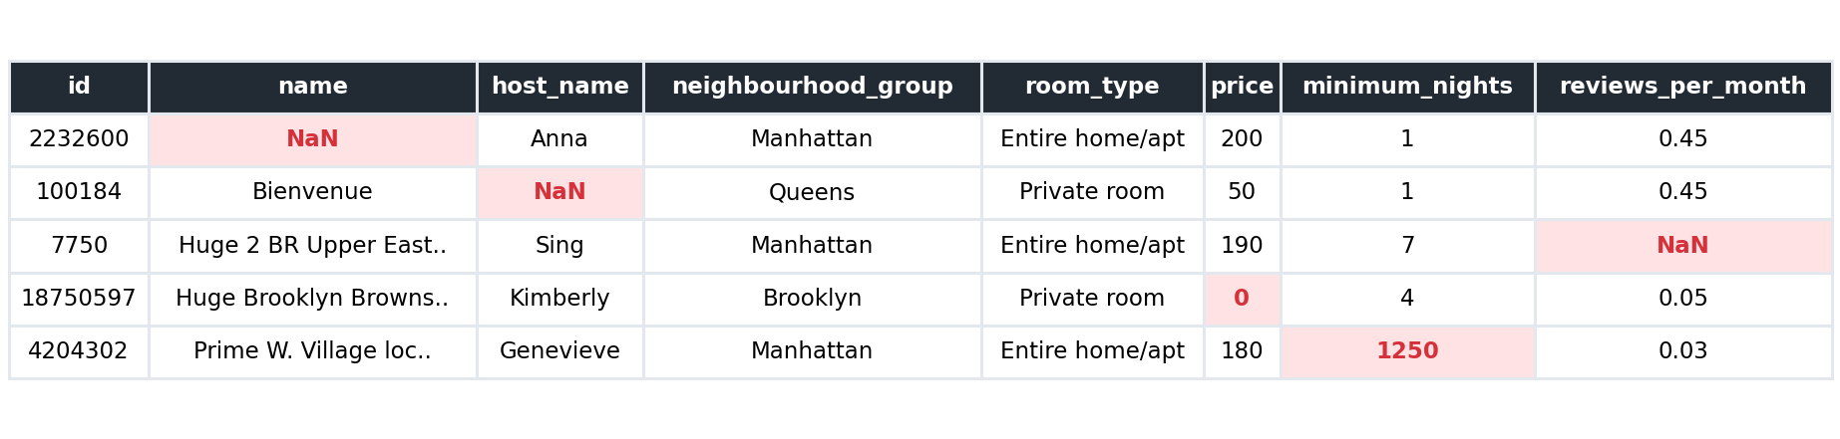
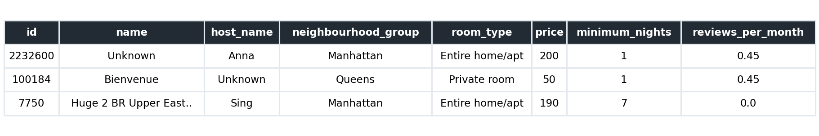
DATA CLEANING
Raw vs. Cleaned Data - Side by Side
Same listings, shown before and after the cleaning pipeline. Highlighted cells mark the exact issues fixed.
BEFORE
AFTER
Missing names, host names and review rates are filled. The listing with a $0 price and the one with a 1,250-night minimum stay are removed, so AFTER shows 3 rows.
AIRBNB NYC PRICE ANALYSIS
6

Slide 7
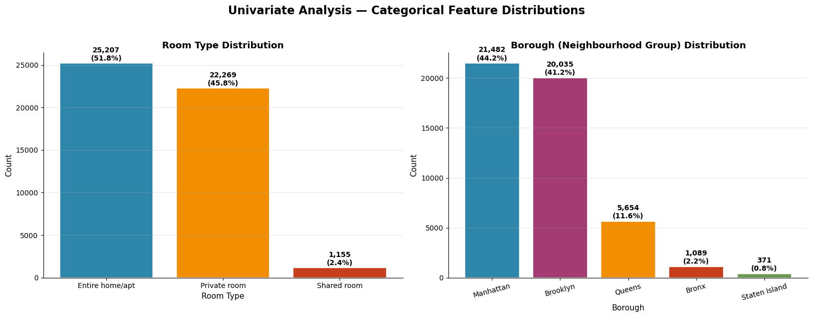
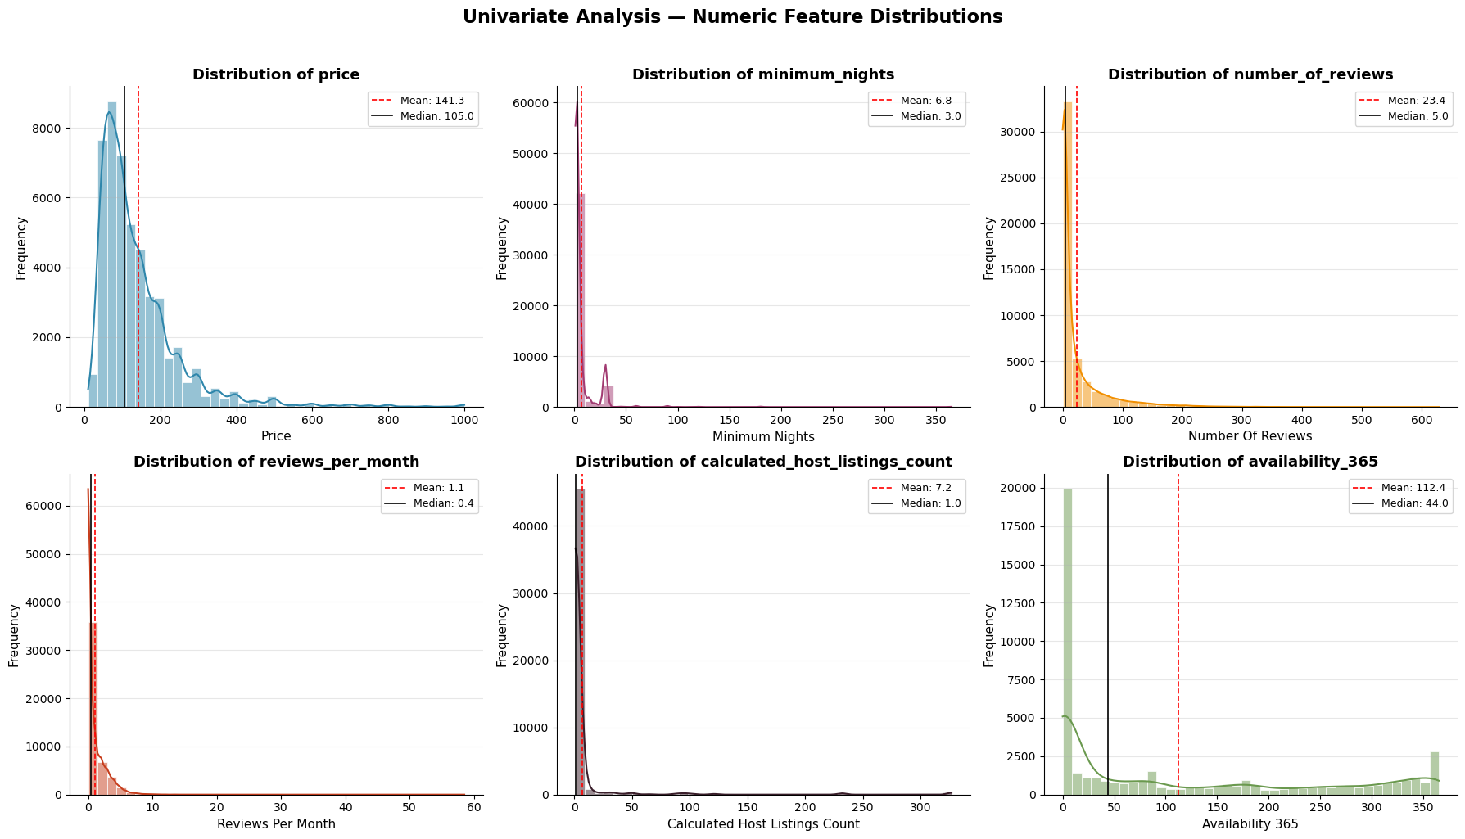
EXPLORATORY DATA ANALYSIS
Univariate Analysis: Listing Mix & Distributions
What this tells us
$105
$141
Median price
Mean price
Entire homes (52%) and private rooms (46%) dominate supply, and Manhattan and Brooklyn hold 85% of listings.
Observation:
Price is right-skewed: a few luxury listings pull the mean above the median. Minimum nights, reviews and reviews per month are also strongly right-skewed, and availability spikes at 0 days (35.9% of listings).
AIRBNB NYC PRICE ANALYSIS
7

Slide 8
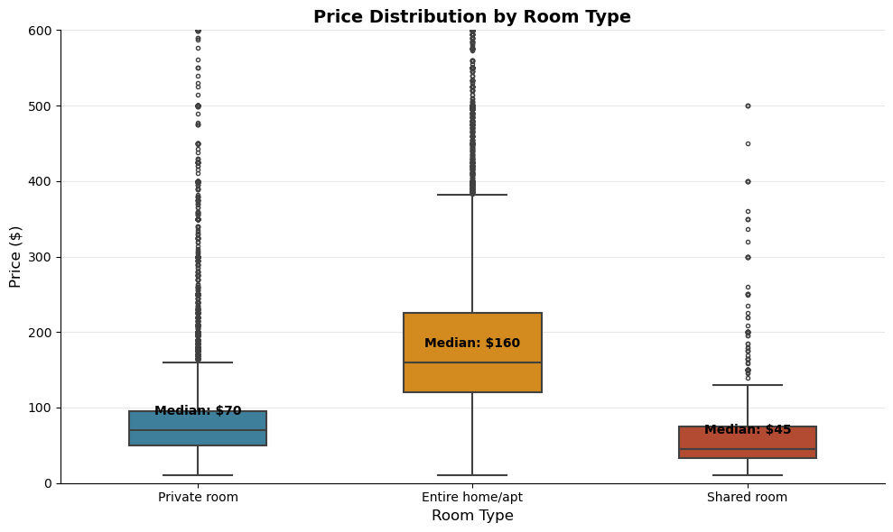
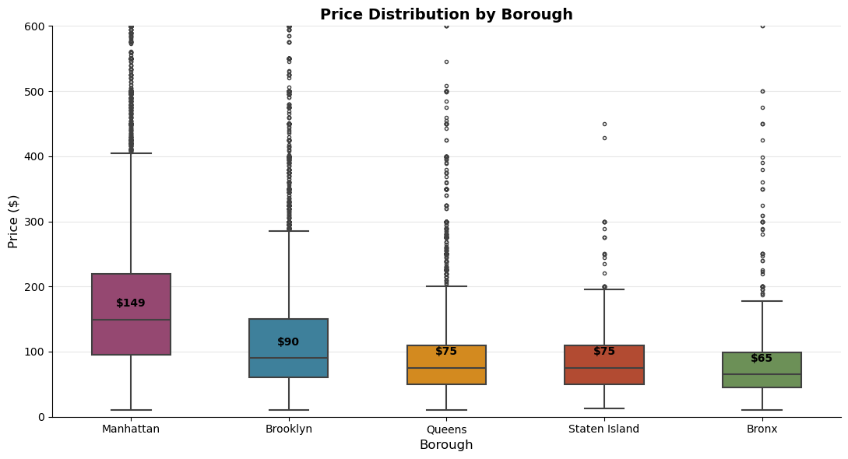
BIVARIATE ANALYSIS
Price Drivers: Room Type & Borough
Price by Room Type
Price by Borough
Entire home/apt
~$160
Manhattan
~$149
Private room
~$70
Brooklyn
~$90
Shared room
~$45
Queens
~$75
Insight
Insight
Entire homes have a median of $160, more than double a private room ($70) and over three times a shared room ($45). Room type is the strongest single price driver.
Manhattan’s median price ($149) is more than double the Bronx ($65). Location is the second major driver, and Manhattan listings are priced at a clear premium.
AIRBNB NYC PRICE ANALYSIS
8

Slide 9
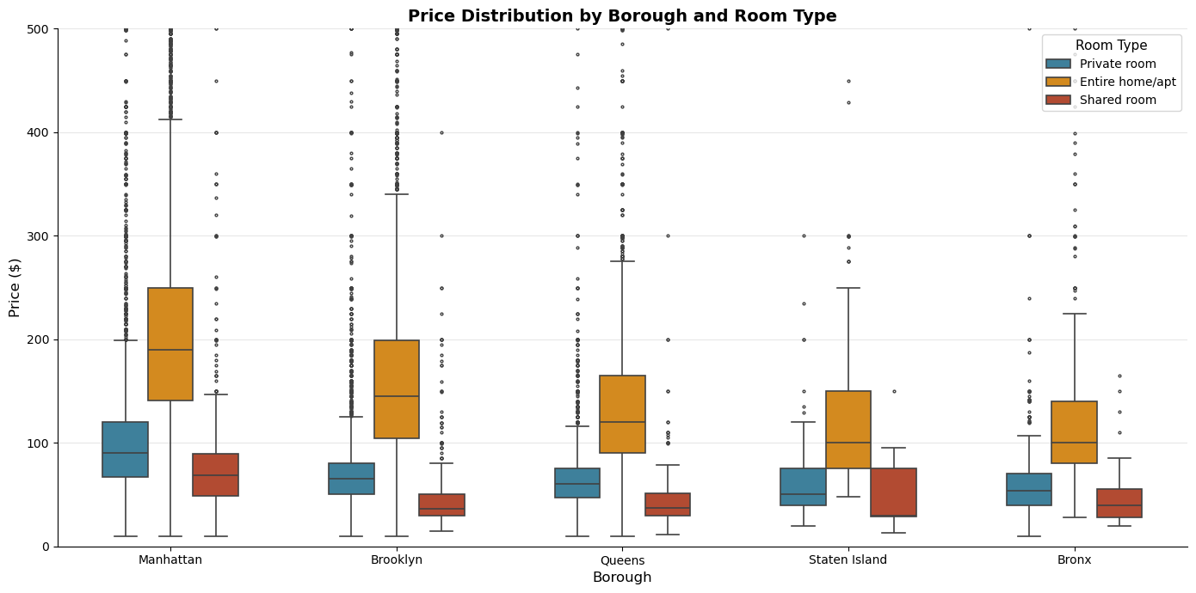
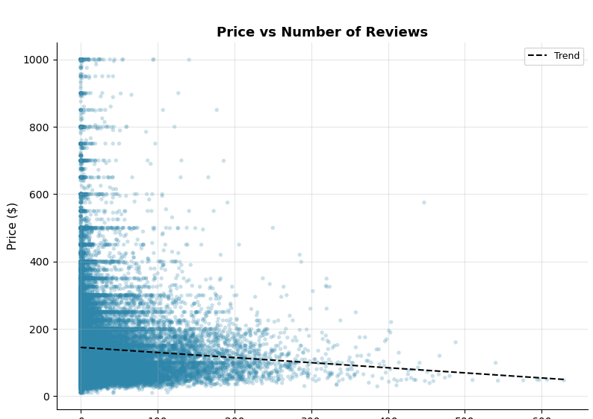
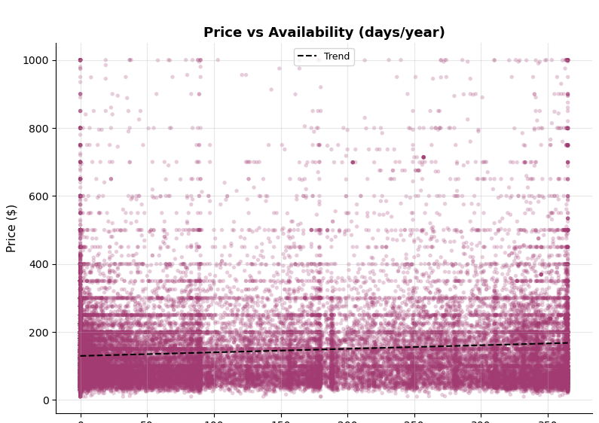
BIVARIATE ANALYSIS
Price by Borough x Room Type & Numeric Features
Price by Borough and Room Type
Numeric Features vs. Price
Manhattan entire home
~$190
Brooklyn entire home
~$145
Queens entire home
~$120
Bronx entire home
~$100
Reviews vs. Price
Availability vs. Price
Insight
Observations
Entire homes cost the most in every borough, led by Manhattan ($190). The gap between room types is wide everywhere, so borough and room type work together.
More reviews do not mean higher prices (r = -0.06), and availability is only weakly related (r = 0.12). Numeric features alone do not explain price.
AIRBNB NYC PRICE ANALYSIS
9

Slide 10
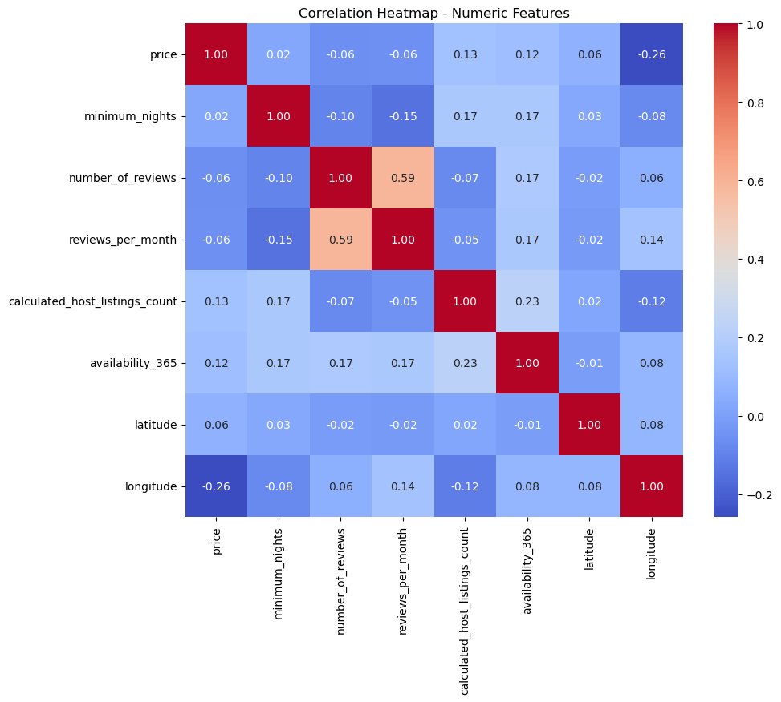
EXPLORATORY DATA ANALYSIS
Correlation Heatmap - Numeric Features
Reading the Heatmap
Price and longitude: the strongest link (r = -0.26). Prices fall as listings move east, away from Manhattan.
number_of_reviews and reviews_per_month: moderate positive correlation (0.59), expected since both measure review activity.
All other features show weak correlation with price (r below 0.15), so no single numeric column explains it.
AIRBNB NYC PRICE ANALYSIS
10

Slide 11
KEY FINDING
The Premium Price Segment
What happens when the two strongest price drivers combine?
Manhattan
Borough
Entire Home
Room Type
+
=
$190
Why this matters
This segment holds 13,048 listings, 26.8% of the market
Guests pay the most here, against only $30 for a Staten Island shared room
A clear benchmark for hosts pricing premium listings: location plus room type
median nightly price in the segment
vs. $105 for all listings - about 1.8x the market median

Slide 12
BUSINESS IMPACT
Market Concentration
Turning listing counts into a clear picture of where supply and pricing power sit.
44.2%
85.4%
35.9%
of all listings are in Manhattan
of listings sit in Manhattan and Brooklyn
of listings are unavailable all year
$149 median price
$149 and $90 median prices
17,463 listings with 0 days available
Share of Listings by Borough
Manhattan
44.2%
85% of supply sits in two boroughs whose median prices differ by $59
Brooklyn
41.2%
Queens, Bronx and Staten Island
14.6%
AIRBNB NYC PRICE ANALYSIS
12

Slide 13
SUMMARY
Key Insights from EDA
1
Median nightly price is $105
2
Entire homes cost 2.3x private rooms
Mean is $141: a few luxury listings skew the distribution
Room type is the strongest single price driver
3
Manhattan is the priciest borough at $149
4
Manhattan and Brooklyn hold 85% of listings
The Bronx median is just $65: location drives a large gap
Supply is concentrated in two boroughs
5
Manhattan entire homes reach $190
6
Numeric features correlate weakly with price
The premium segment: about 1.8x the overall median
Strongest is longitude (r = -0.26): room type and location matter more
AIRBNB NYC PRICE ANALYSIS

Slide 14
Conclusion
What this analysis found
This EDA turned a messy 48,895-listing Airbnb dataset into a clean, machine-learning-ready dataset of 48,631 listings. It showed that price is driven mainly by room type and location, with Manhattan entire homes as the premium segment at a $190 median nightly price.
Data Cleaning • Exploratory Data Analysis • Business Insight Generation

Slide 15
Thank You
Questions & Discussion Welcome
$105
$190
48,631
Median nightly price
Manhattan entire homes
Clean listings
SP
SHAILESH PAWAR
Back to Start
Key Insights
Airbnb NYC Price Analysis | EDA Project
linkedin.com/in/shaileshpawar-cse
github.com/Shailesh-Pawar-18

